Slide 1
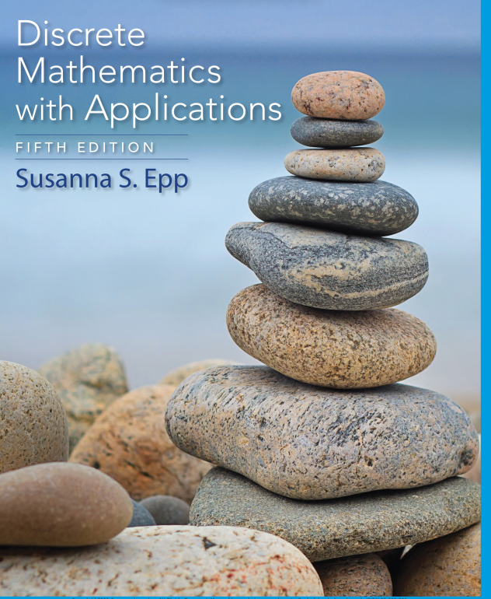
Chapter 1
Database Systems

Slide 2

Faculty of Computer Science
UFCFFS-30-1– Foundations of Computing: Mathematic Induction & Recursion
Instructor: Duc Minh Vu
2/5/2024
Data Structures and Algorithms in Python
2

Slide 3
Learning Objectives
Describe the features of a queue and the operations on it
Choose a queue implementation based on its performance characteristics
Recognize applications where it is appropriate to use a queue
Explain the difference between a queue and a priority queue
Recognize applications where it is appropriate to use a priority queue

Slide 4
Reading
Chapter 5 - Discrete Mathematics with Applications 5th Edition (Susanna’s Book)
Chapter 5 – Discrete Mathematics and Its Applications 7th Edition (Kenneth Rosen’s book)

Slide 5
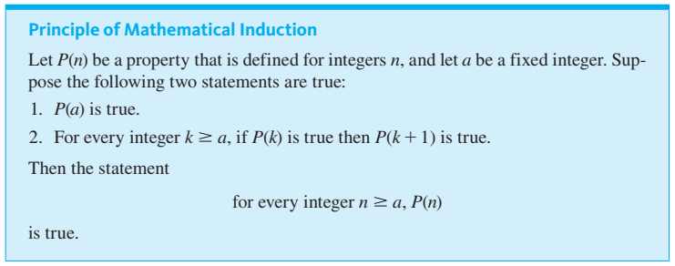
Mathematical Induction I: proving Formulas

Slide 6
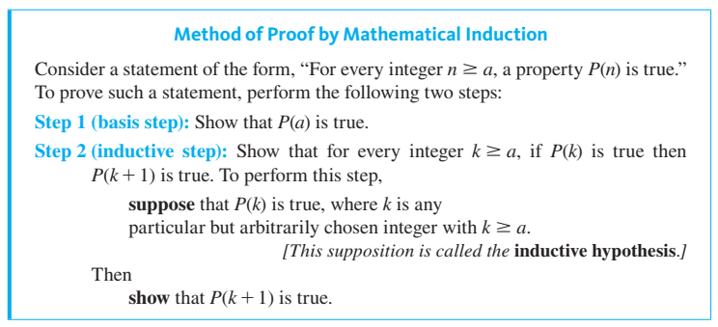

Slide 7
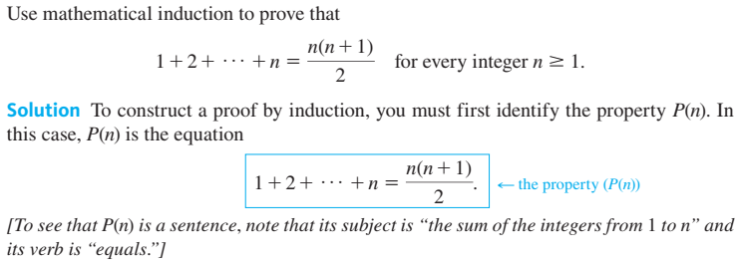
Sum of the First n Integers

Slide 8



Slide 9


Slide 10
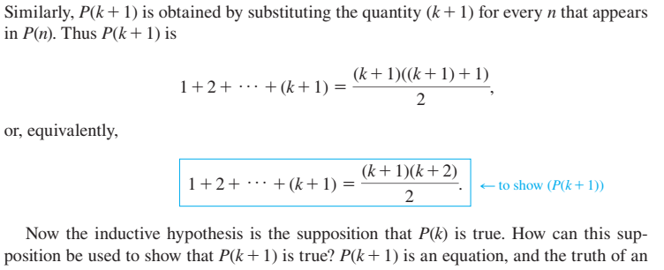

Slide 11
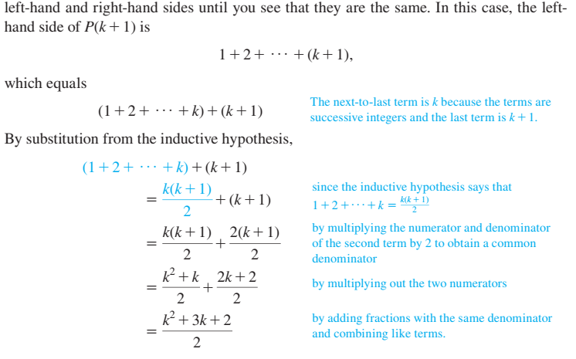

Slide 12


Slide 13
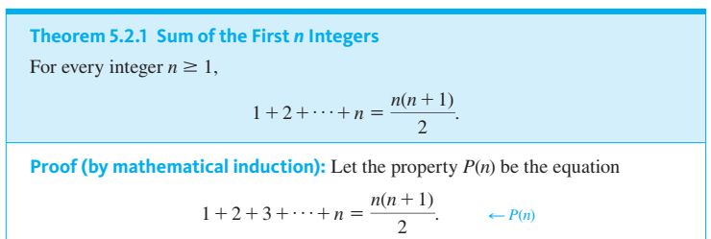

Slide 14


Slide 15
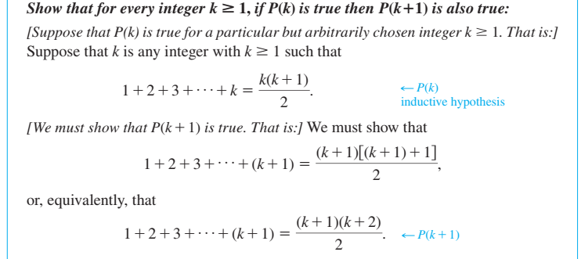

Slide 16
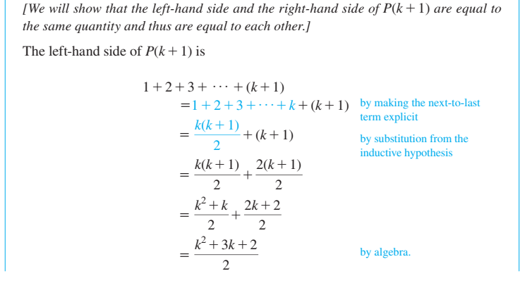

Slide 17
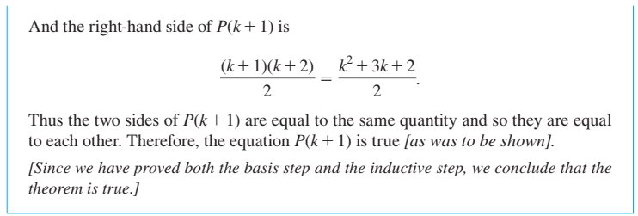

Slide 18
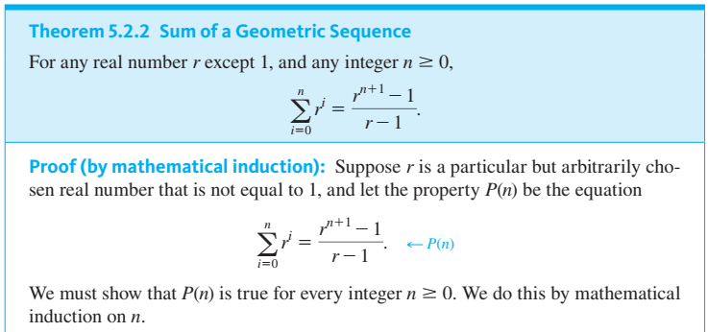
Theorem 5.2.2 Sum of a Geometric Sequence

Slide 19
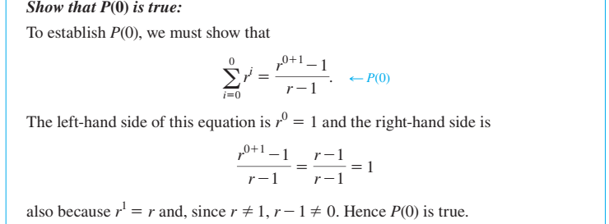

Slide 20

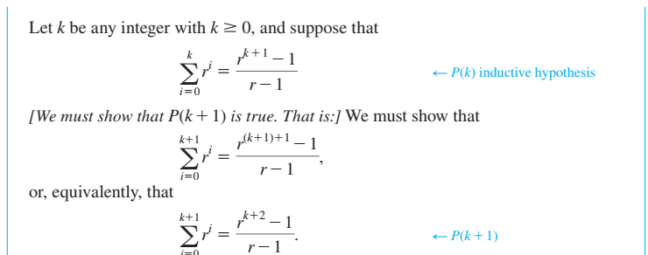

Slide 21
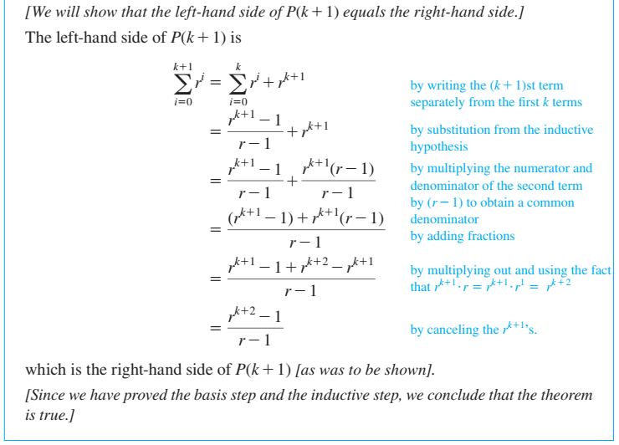

Slide 22
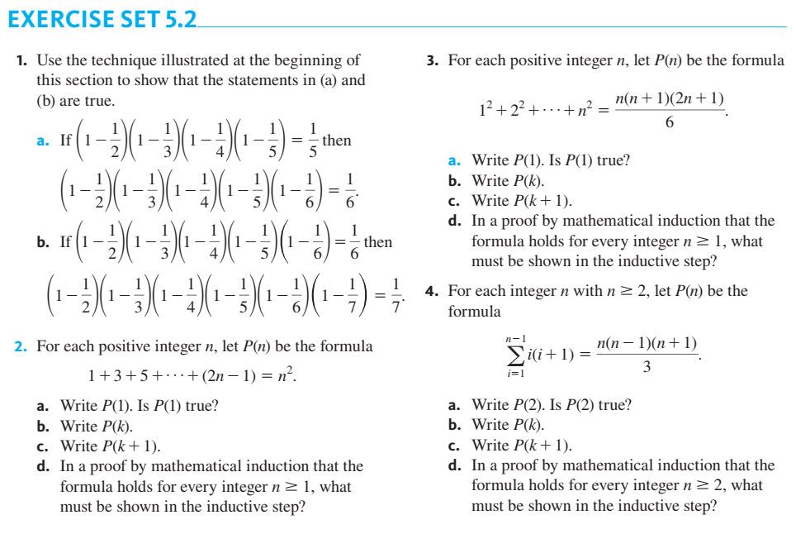

Slide 23
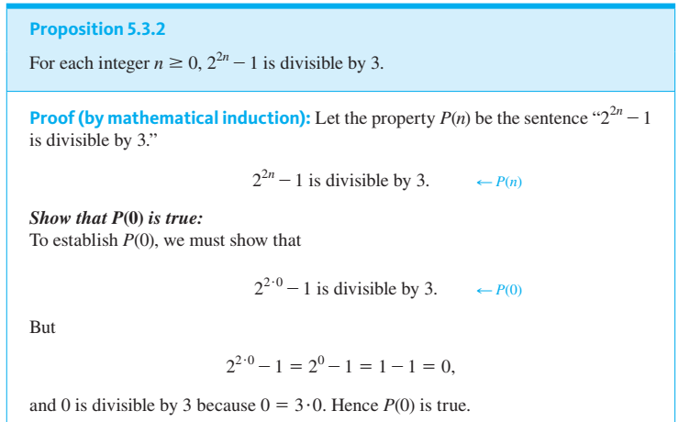
Mathematical Induction II: Applications

Slide 24

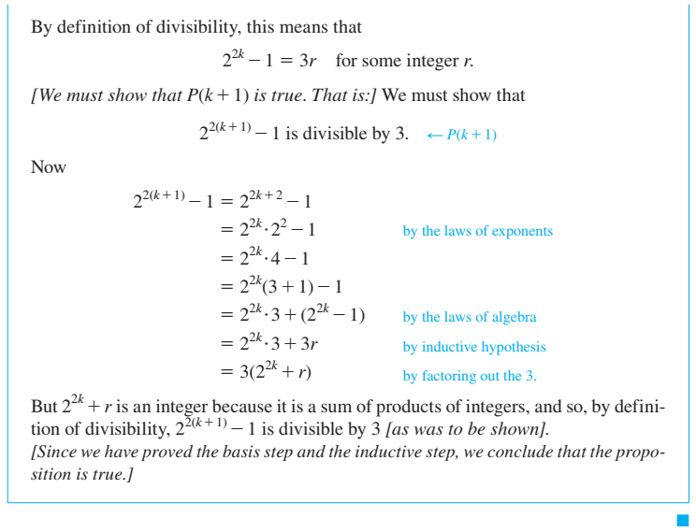

Slide 25
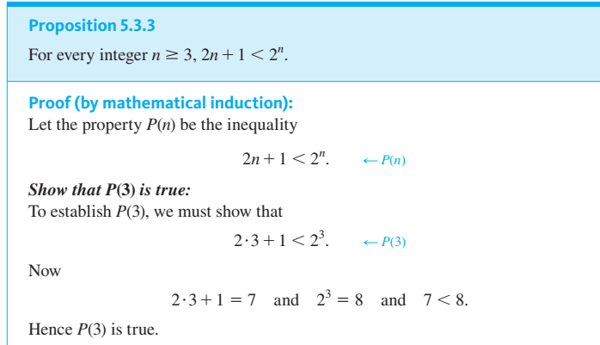

Slide 26
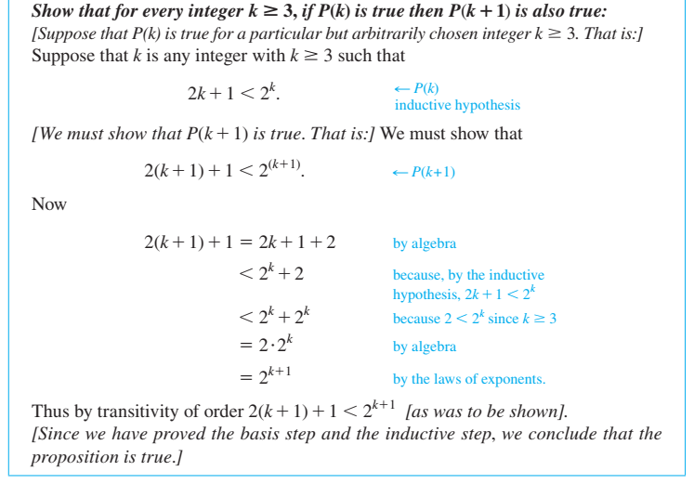

Slide 27
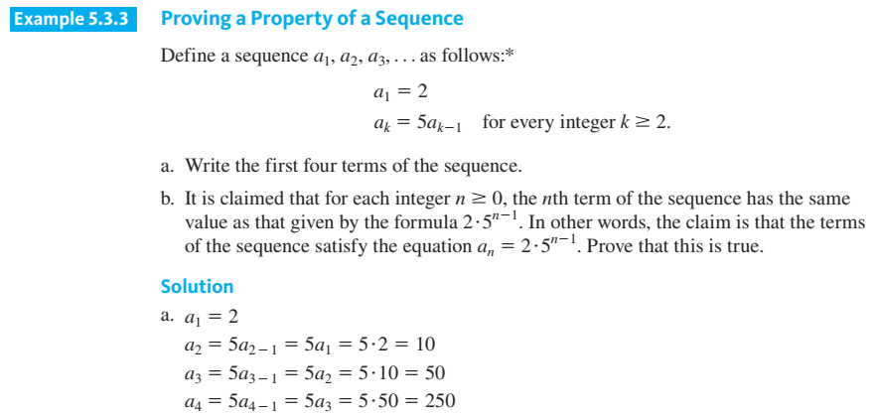

Slide 28
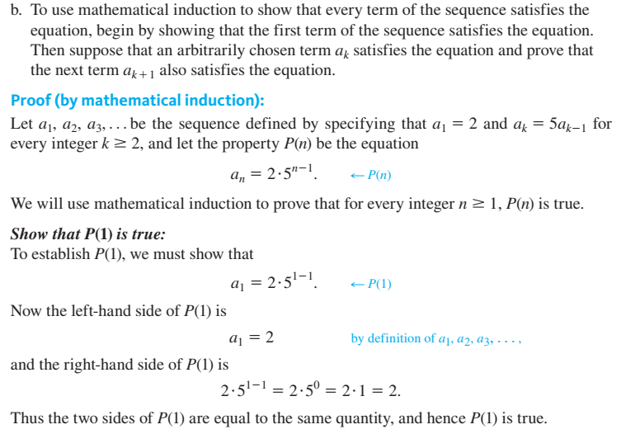

Slide 29

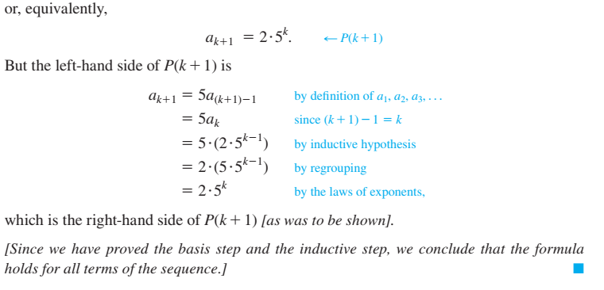

Slide 30
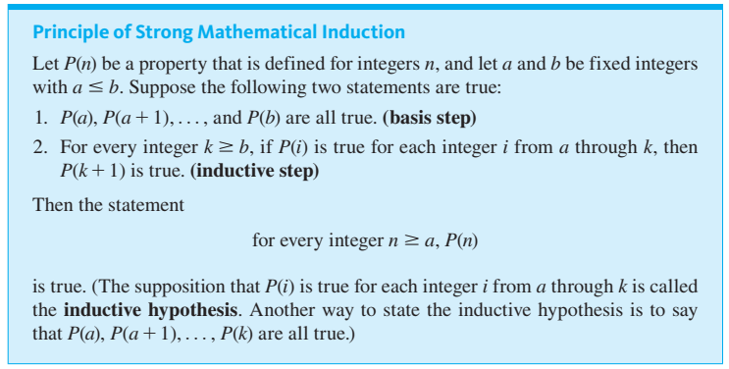

Slide 31
Strong Mathematical Induction and the Well-Ordering principle for the Integers

Slide 32


Slide 33
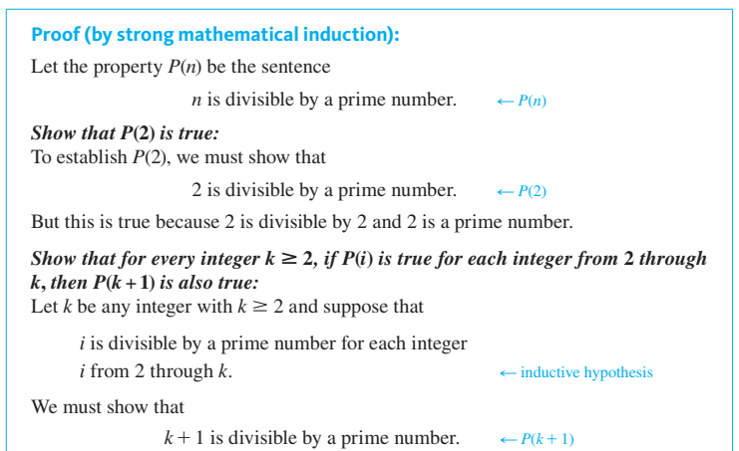

Slide 34



Slide 35
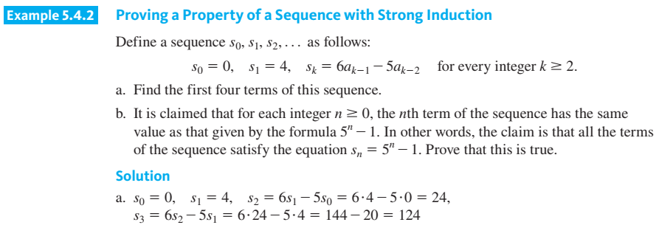

Slide 36
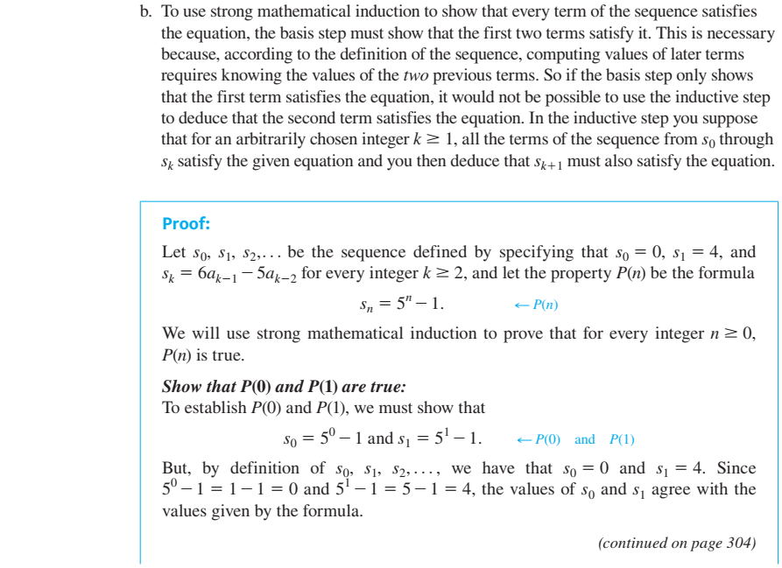

Slide 37
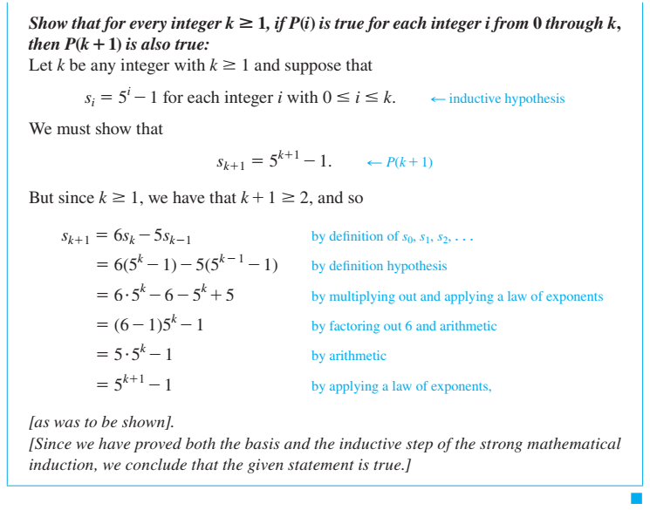

Slide 38
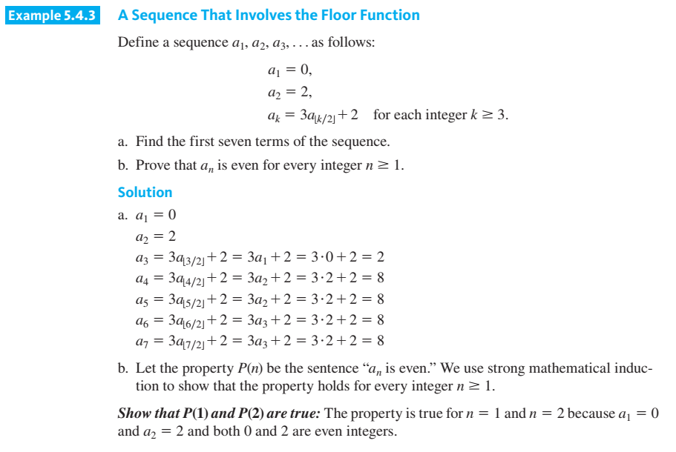

Slide 39
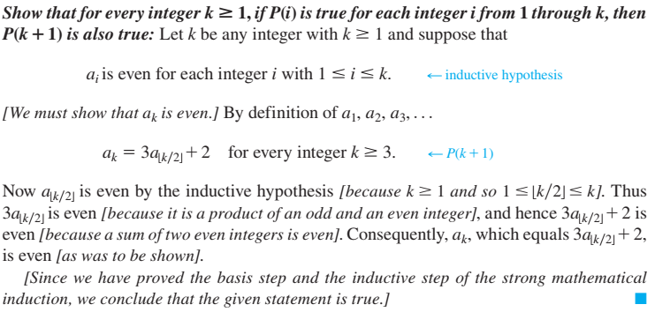

Slide 40
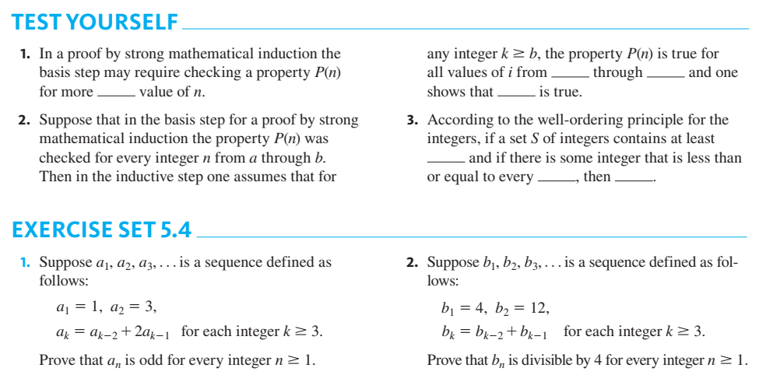

Slide 41
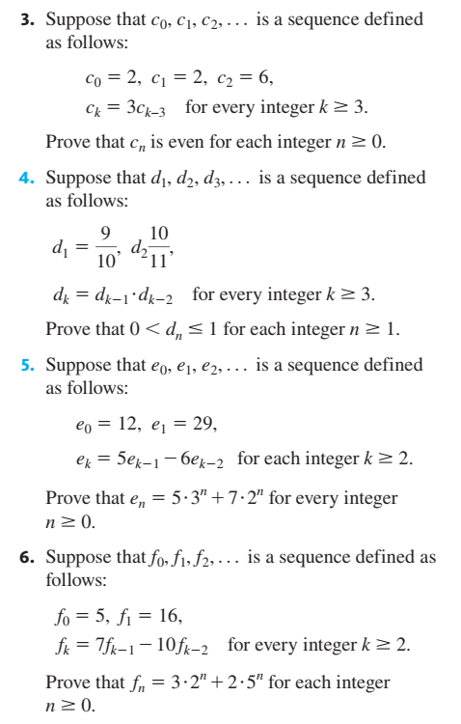
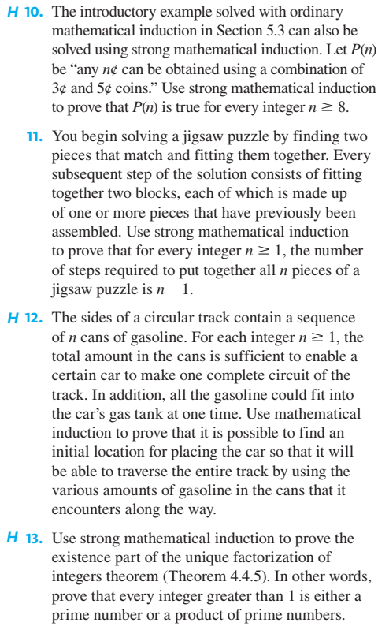

Slide 42
Application: Correctness of Algorithms

Slide 43


Slide 44
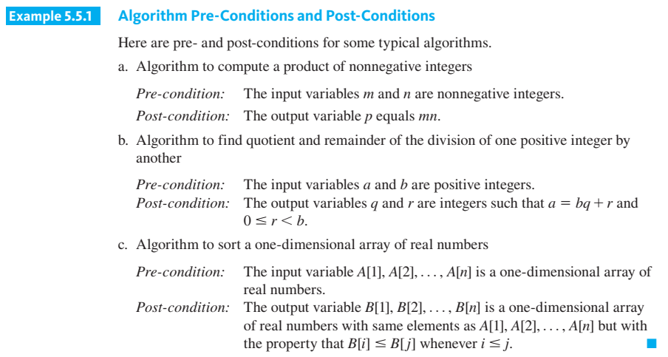

Slide 45
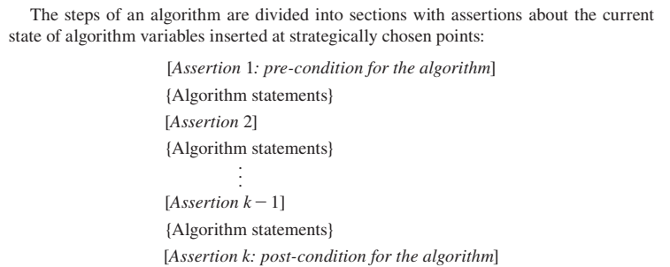

Slide 46
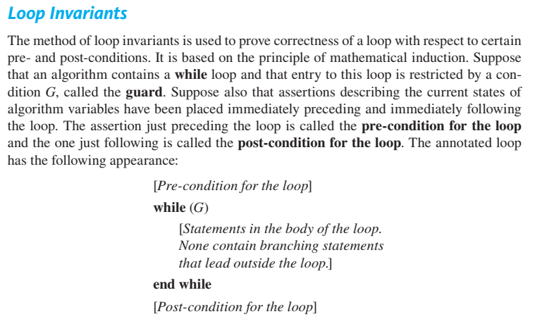

Slide 47


Slide 48
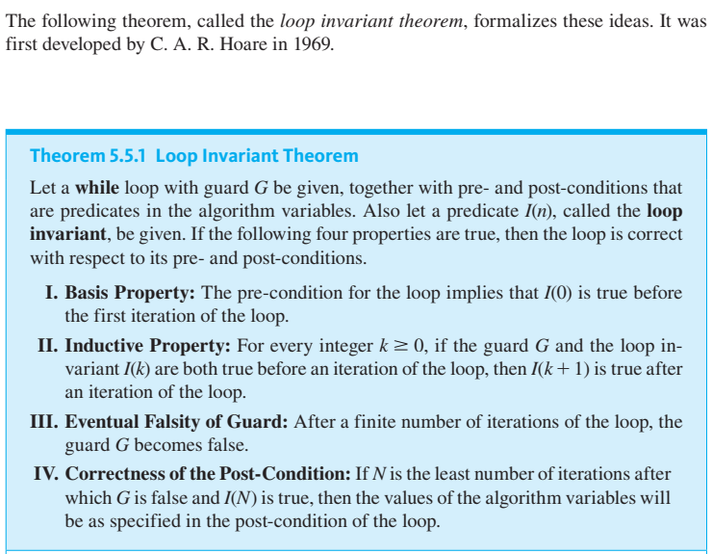

Slide 49
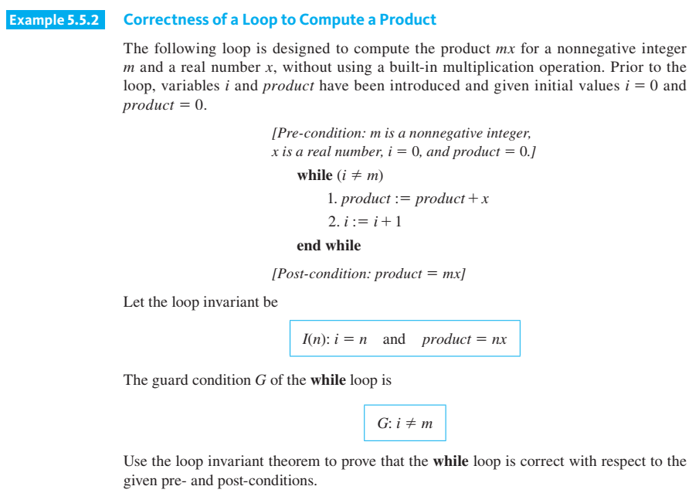

Slide 50
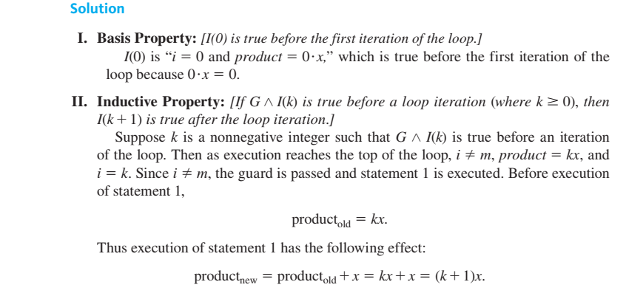

Slide 51
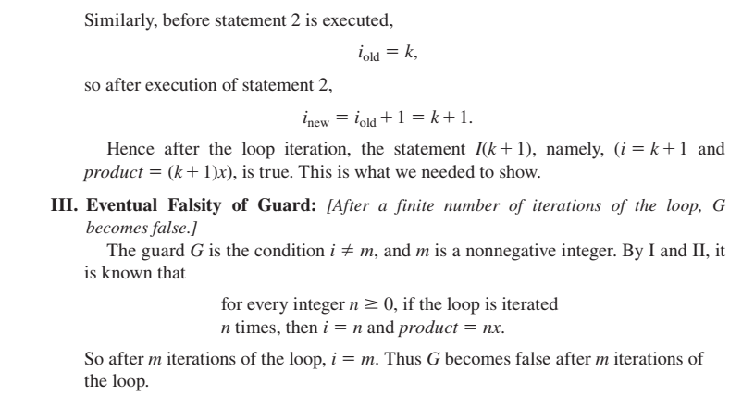

Slide 52


Slide 53
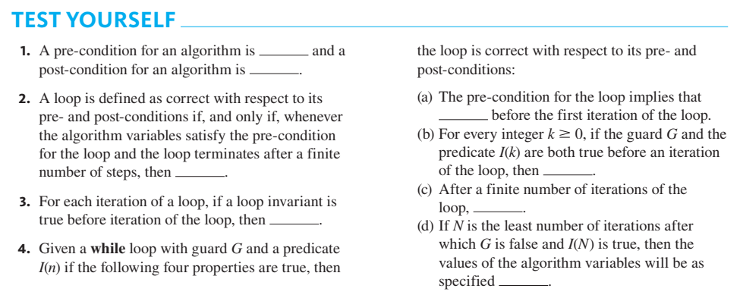

Slide 54
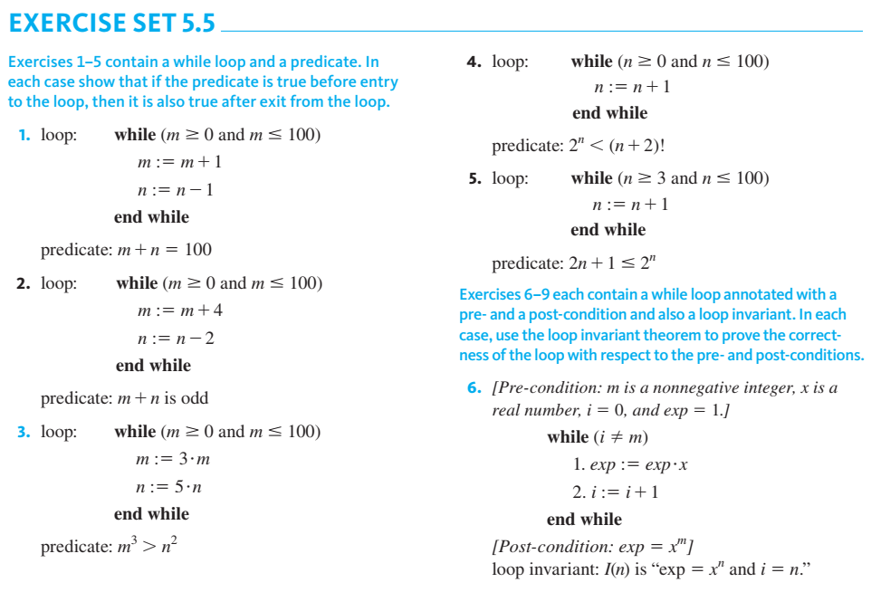

Slide 55
